Slide 1


Rosemount 2230 Graphical Field Display

Slide 2
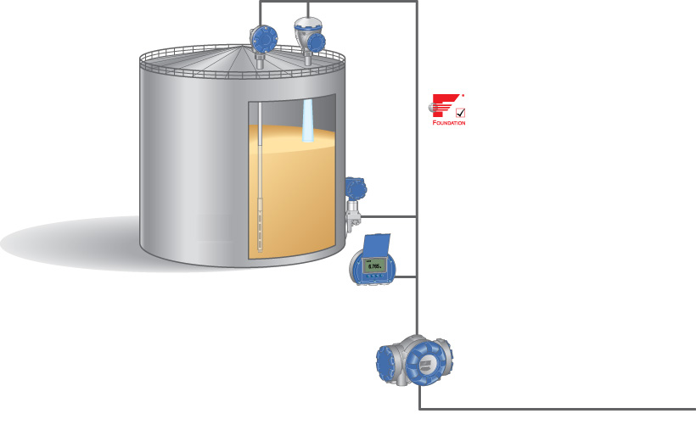
System Overview
2240S Multi-Input Temperature Transmitter
5900S Radar Level Gauge
Tankbus: FOUNDATIONTM fieldbus
3051S Pressure Transmitter
2230 Graphical Field Display
2410 Tank Hub
Fieldbus

Slide 3
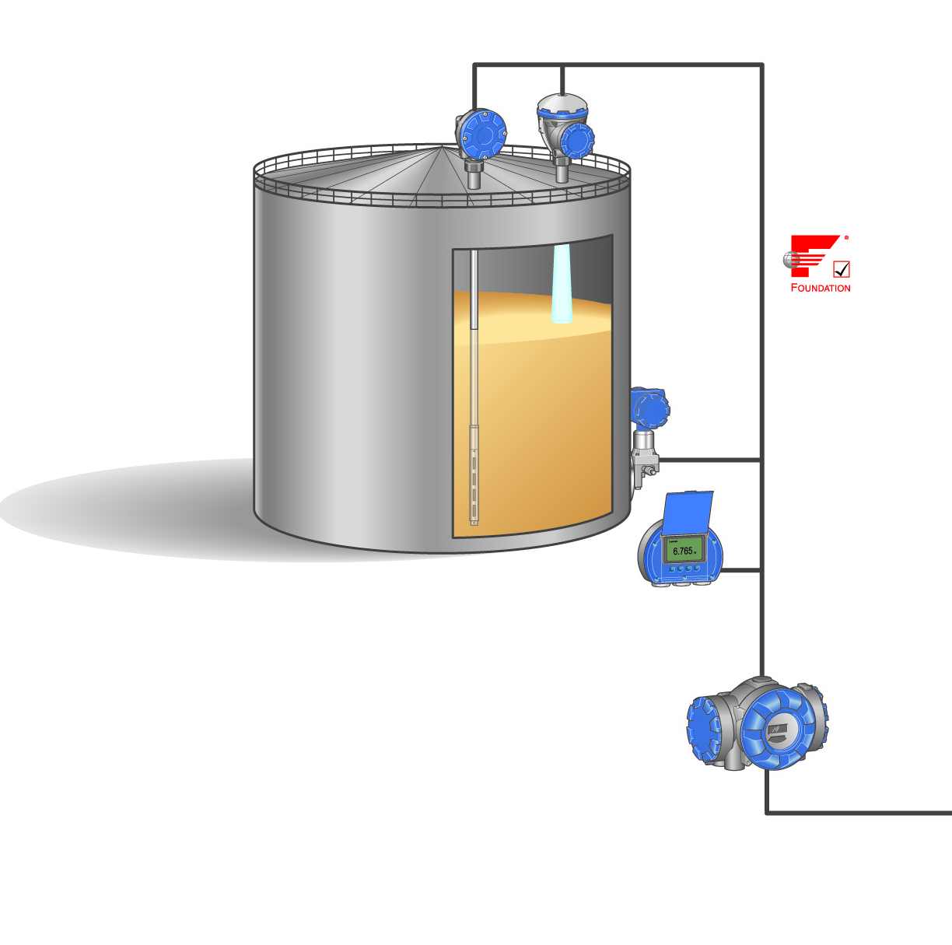
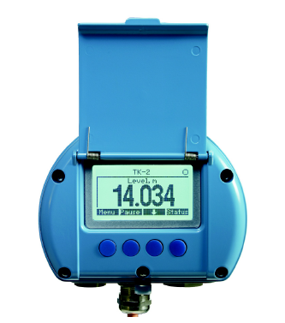
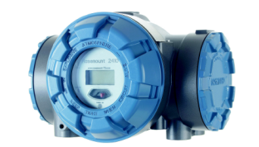
2230 Graphical Field Display
Presents inventory Tank gauging data from the hub
Language selection possibilities
English, French, German, Spanish, Italian, and Portuguese
Custody Transfer View
Displays Level & Avg temp for each tank
Up to 3 displays connected to one tank hub

Slide 4
2230 Graphical Field Display
4 panel buttons for easy navigation
Field configuration
view and units
Data update time: 2s
Backlit LCD
Remote installation
Pipe/wall installation kit (optional)

Slide 5
Available Field Data
Viewable variables
Level | Vapor temperature
Ullage | Product temperature
Level rate | Tank average temperature
Signal strength | Temperature spot 1 to 16
Free water level | Observed density
Vapuor pressure | Reference density
Liquid pressure | Flow rate
Air pressure | Total Observed Volume
Ambient temperature | User defined 1 to 5

Slide 6
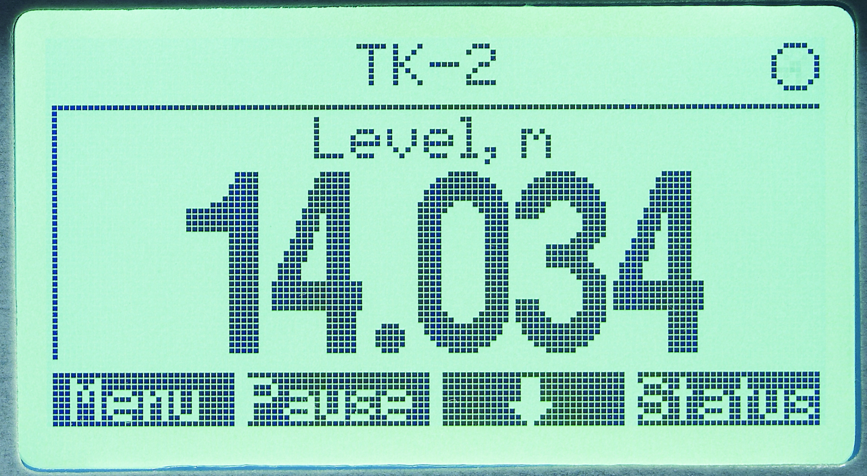

2230 Graphical Field Display
Large-sized digits, 25 mm (1 in.) in single value view
Tank name (up to 10 tanks)
”Live” indication
Alarm /Error symbol
Four soft keys

Slide 7
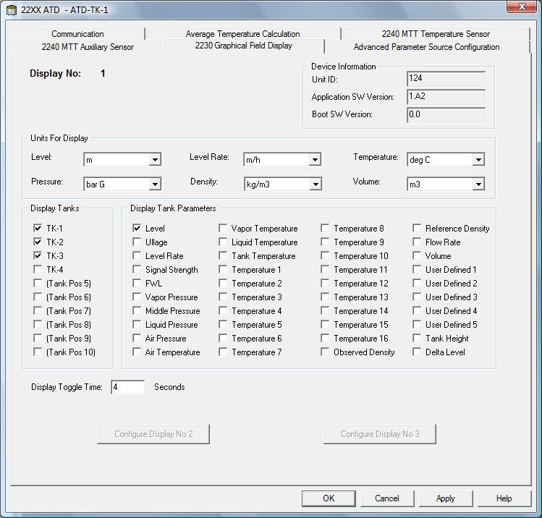
Configuration via TankMaster

Slide 8
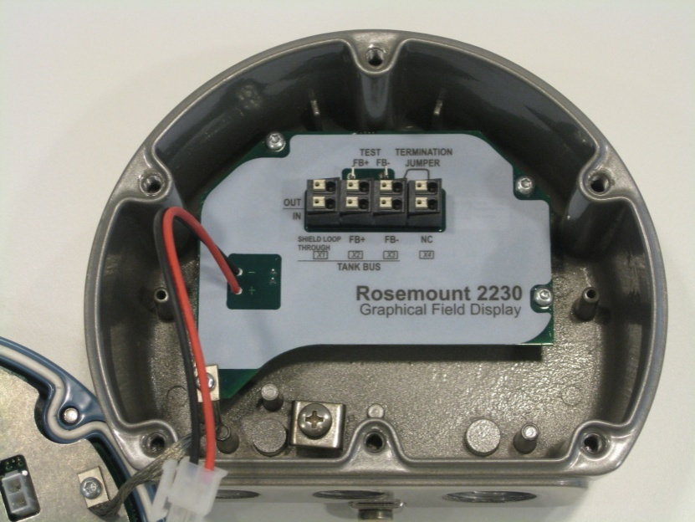
2230 Installation Considerations
Intrinsically safe
Mount on a plate towards a wall or similar
Optional pipe/wall installation kit
Powered over the Tankbus from 2410
Requires 30 mA
Daisy-chain connection possible
Built-in termination jumper
To be connected if required
Configured in TankMaster

Slide 9
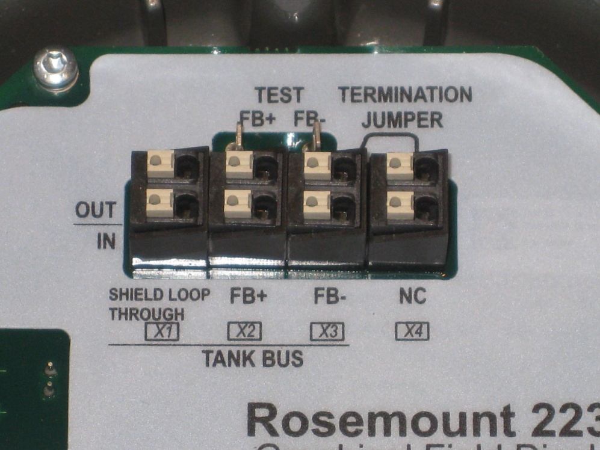
Wiring
Tankbus
X2 and X3 terminal
Output for daisy-chain
Cable shield
X1 terminal
Termination jumper
X3 (-) output and X4
Only if it is the last device on the Tankbus
X1:Cable Shield
X2: Tank Bus (+) output
X3: Tank Bus (-) output
Temination jumper
X1:Cable Shield
X2: Tank Bus (+) input
X3: Tank Bus (-) input
X4: Tankbus terminator
*Dual Terminals for Daisy chaining the field

Slide 10
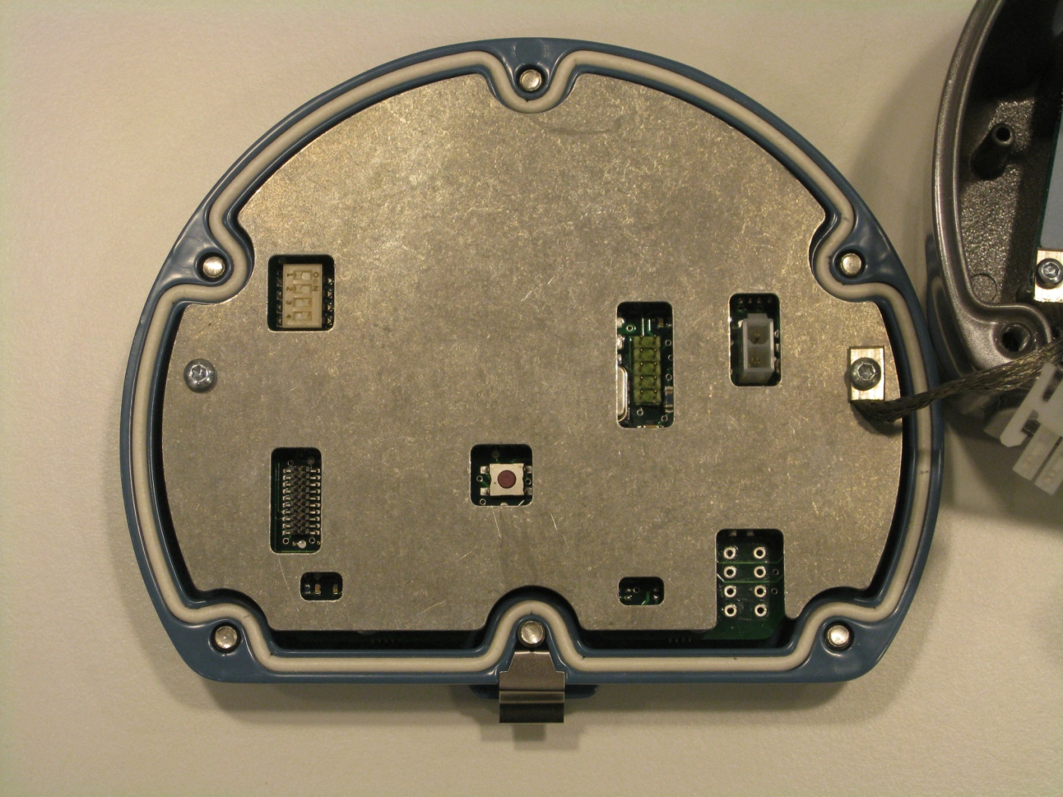
LEDs and Dip Switches
Dip Switch
Write Protection
Transmit/ Receive LEDs
Status LED
Reset button

Slide 11

Switches
Switches
Simulates measurement values from tanks
Write protect
Protects all configuration in 2230
Reset button
Restores configuration to factory settings
1
2
3
4
Number | Name | Description
1 | Simulate | Enables simulation of tank monitoring
2 | Write Protect | Enables write protection of configuration data
3 | Spare | Not used
4 | Spare | Not used
Notes:
Ta reda på mer om hur simulation fungerar

Slide 12
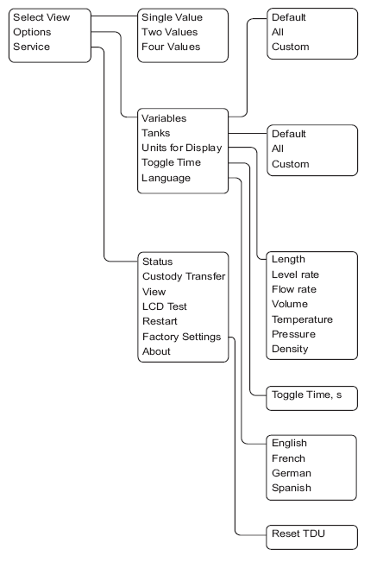
Configuration options
TankMaster
Described in WinSetup presentation
Display softkeys
Tree based menu
Selectable options
Variables
Tanks
Units
Toggle Time
Language
Service Menu
For display troubleshooting in field

Slide 13
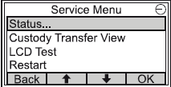
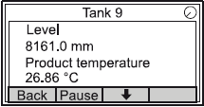

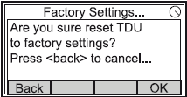
Service Menu
Status
Current status for network and hardware
Custody Transfer View
Displays Level & Avg temp for each tank
LCD Test
Chequered pattern to test the whole display area
Returns to normal mode when test is completed
Factory Settings
Restore factory settings, all user configuration will be lost
Restart & About

Slide 14
Display contrast
Increase contrast
Press the two buttons on the right-hand side simultaneously
Decrease contrast
Press the two buttons on the left-hand side simultaneously
Decrease contrast
Increase contrast

Slide 15
Reset the 2230 to factory settings
Two ways to reset the 2230:
Internal button
Press to restore factory settings
WinSetup
Send reset command via field bus
Holding register 65510
Reset button
Notes:
Hur funkar default load... ??

Slide 16
Troubleshooting
Symptoms | Actions
No communication with 2230 using FISCO | Faulty communication cabling – check cabling No fieldbus termination or too many terminations Make sure that the last devices in the FISCO fieldbus is terminated
No possible to change configuration | Make sure hardware write protection switch is off Remove software write protection using TankMaster Winsetup
NOTE! Firmware cannot be ugraded in field!

